Slide 1
Weather Analysis of Major Cities
Foundation of Data Analytics
J Component Review 01
Altaf Pathan 20BCE1848 -Mentor
Kumar Siddharth 20BCE1287
Prakhar Sachan 20BCE1196
Vishvajeet Ravalekar 20BCE1098

Slide 2
Analyzing climatic conditions of Major Cities around the World

Slide 3

Introduction
Weather forecasting plays a vital role in our daily life because due to the polluted environment temperature, rainfall , evaporation, wind speed, humidity, pressure , moisture will change over time to time. These can affect the daily routine life of the human beings data analytics is the process of analyzing big data to extract the concealed patterns and applicable information that can yield better results. Nowadays, several parts of society are interested in big data, and the meteorological institute is not excluded. Therefore, big data analytics will give better results in weather forecasting and will help forecasters to forecast weather more accurately. In order to achieve this goal and to recommend favorable solutions, several big data techniques and technologies have been suggested to manage and analyze the huge volume of weather data from different resources.

Slide 4
Abstract
Many cities in the world have a typical weather condition consisting of various seasons and geographical conditions. They have extreme high temperatures in regions like Arizona, Sahara, Thar and cold climate at Himalayas, Tundra regions and heavy rainfall at Chirapunji, Japan. These extreme variations in temperatures make us to feel difficult in inferring / predictions of weather effectively. It requires higher scientific techniques / methods for plotting and pre-processing of data. In this project, we will apply different methods and algorithms for grouping similar data sets together and also apply classification technique along with linear regression analysis. Programming will be done in programming languages like R and Python.

Slide 5
Literature Review
Weather forecasting has been one of the most challenging difficulties around the world because of both its practical value in popular scope for scientific study and meteorology. Weather is a continuous, dynamic ,multidimensional chaotic process, and data-intensive and these properties make weather forecasting a stimulating challenge. It is one of the most imperious and demanding operational responsibilities that must be carried out by many meteorological services all over the globe. Various organizations / workers in India and abroad have done demonstrating using supported time series data manipulation. The various methodologies viz. statistic decomposition models, Exponential smoothing models, ARIMA models and their dissimilarities like seasonal ARIMA models, vector ARIMA models using flexible time series, ARMAX models i.e. ARIMA with following informative variables etc., which has been used for forecasting purposes. Many trainings have taken place within the analysis of pattern and circulation of rainfall in many regions of the world. Totally altered time series methods with different purposes are used to investigate weather information in many different literatures. Accurate and timely weather forecasting is a major challenge for the scientific research. Weather prediction modelling involves a combination of many computer models, observations and acquaintance of trends and designs. Using these methods, practically accurate forecasts can be made up. Regression is a statistical experimental technique and it must be widely used in many business, the behavioural sciences, social and climate recasting and many other areas.

Slide 6
DataSets Used
Wind.csv:
Consists of attributes:
"MinTemp", "MaxTemp","Rainfall", "Evaporation", "Sunshine", "WindGustDir","WindGustSpeed", "WindDir9am", "WindDir3pm", "WindSpeed9am", "WindSpeed3pm", "Humidity9am”, "Humidity3pm", "Pressure9am", "Pressure3pm" "Cloud9am", "Cloud3pm" ,"Temp9am" ,"Temp3pm", "RainToday","RISK_MM" ,"RainTomorrow"
Each row in dataset represents a day. All the attributes like wind, rain, pressure, clouds, etc are represented as attributes.
e.g. Day1: Max Temperature, Min Temperature, Pressure, Wind Speed…………….

Slide 7


Programming Languages used
R
(4.2.1)
Python (3.9.12)
Library: Ggplot2, dplyr
Libraries: NumPy, Pandas, MatPlotLib, sklearn, graphviz
Tools: R, VSCode
Tools: Jupyter NoteBook, Excel

Slide 8
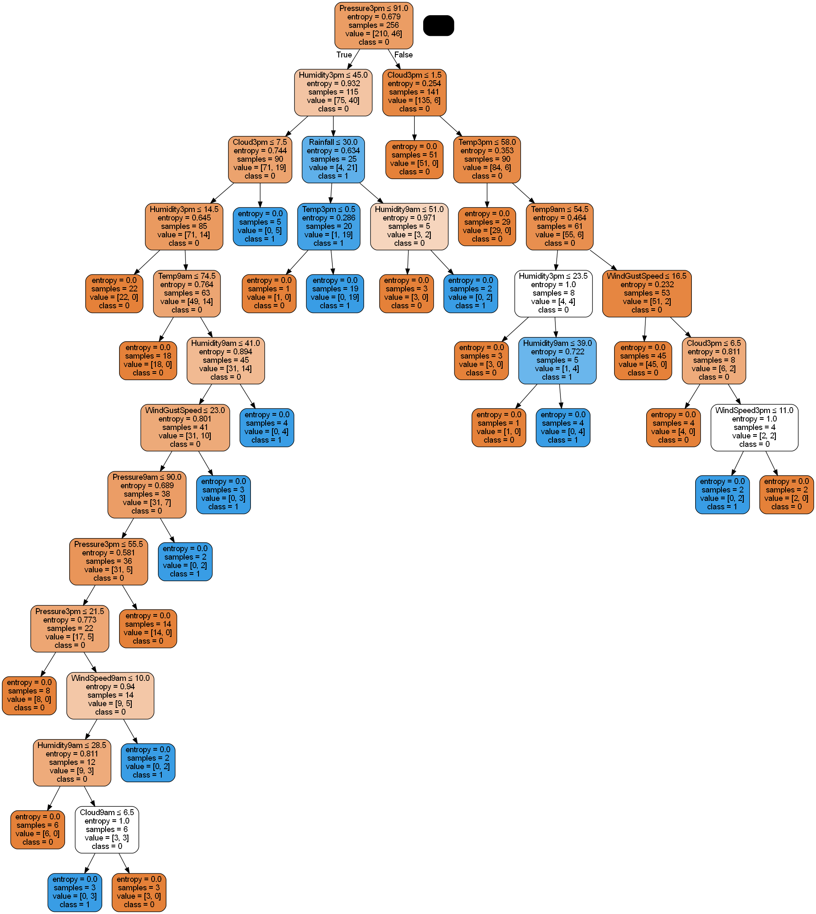
Model 1: Decision Tree
Decision Tree
Observation: Risk calculation and Prediction of Rain Tomorrow based on classes in input.
Accuracy: 0.7575

Slide 9
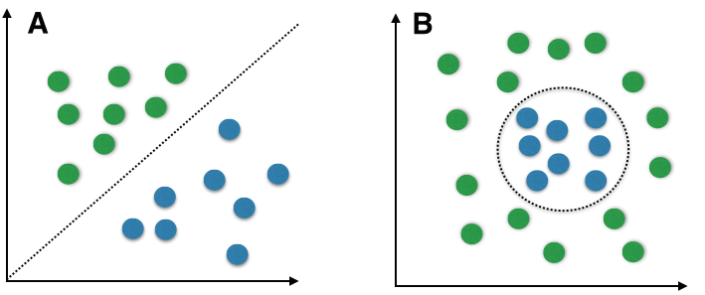
Model 2: Bayes Classification
Bayes Classification
Observation: Predicting rain based on probability of Raining Today vs Not Raining
Accuracy: 0.9181

Slide 10
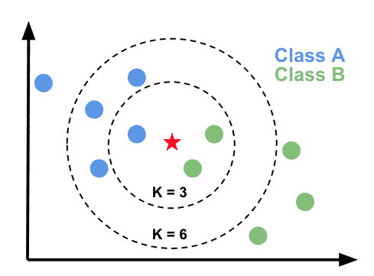
Model 3: KNN Classification
KNN Classification
Observation: Classifying based on previous data when it rained or not. Which ones are closer have more chances.
Accuracy:
Three Neighbors: 0.8727
Five Neighbors: 0.9
Seven: 0.8909
Nine: 0.8818
Eleven: 0.8818
Thirteen: 0.8636
Best accuracy is obtained on 5 neighbors
Best Accuracy: 0.9

Slide 11
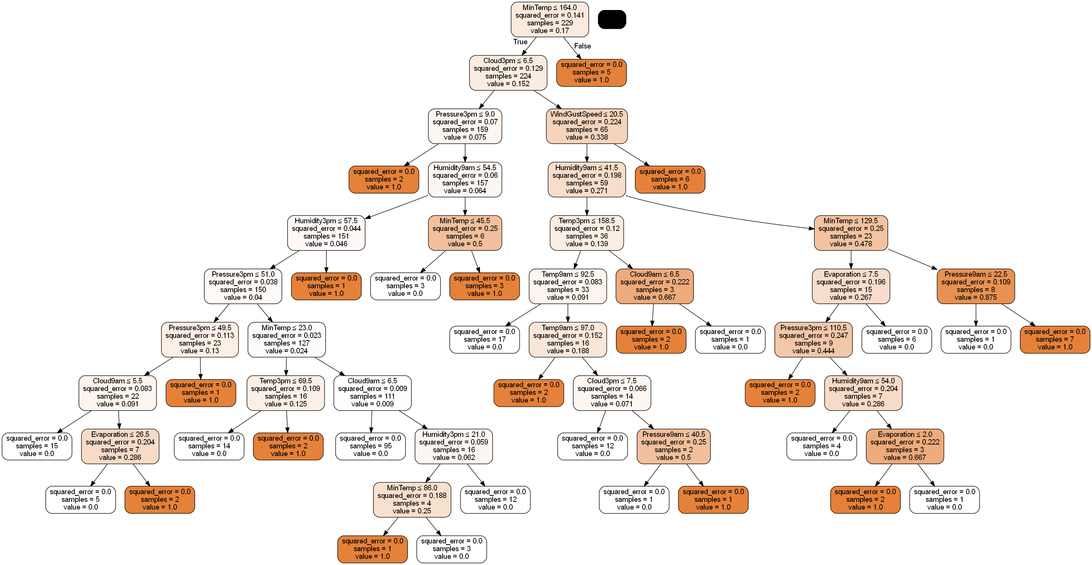
Model 4: Regression Tree
Regression Tree
Observation: Predicting Rain based on numerical values like Temperature, Pressure, Humidity, etc
Accuracy: 0.8484

Slide 12
Best Model: Supervised
Bayes Classification
Naïve Bayes or Bayes Classification gave the highest accuracy of 91.81% for rain prediction. Since, different models fit differently for different datasets, Bayes Classification fits best for the above dataset.
Accuracy: 0.8484

Slide 13
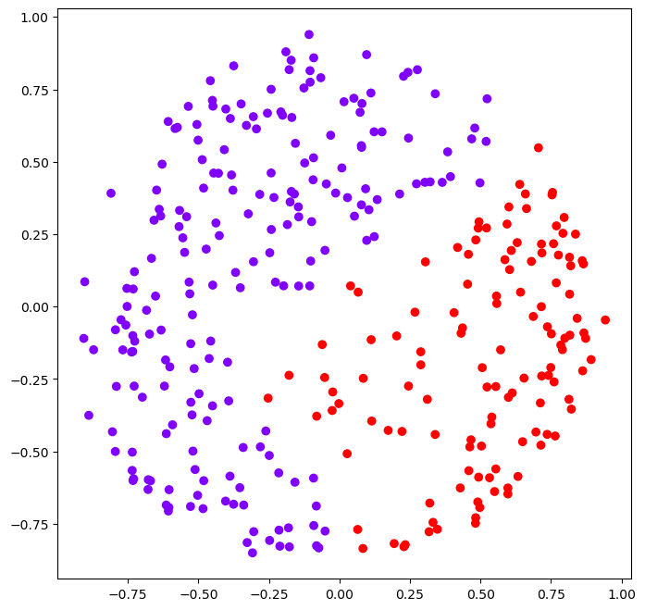
Model 5: Heirarchical Clustering
Agglomerative Clustering
Observation: Since this is unsupervised algorithm, it classifies data into two clusters. Cluster1 (purple) represents the days on which it will not rain, while red dots represent days on which it will rain.

Slide 14
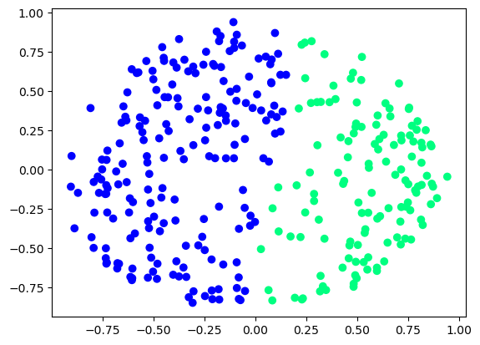
Model 6: K-Means
K-Means Clustering
Observation: Since this is unsupervised algorithm, it classifies data into two clusters. Cluster1 (Blue) represents the days on which it will not rain, while green dots represent days on which it will rain.
This is slightly inaccurate than Agglomerative Clustering

Slide 15
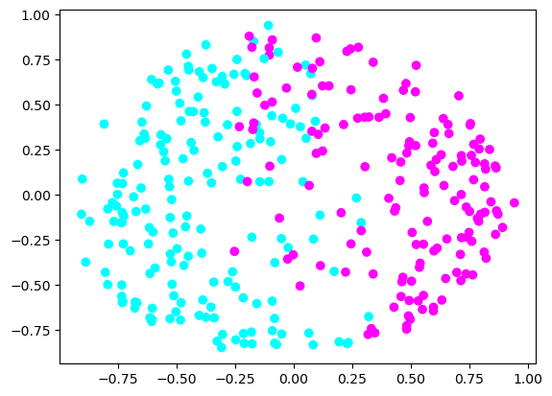
Model 7: K-Medoid
K-Medoid Clustering
Observation: Since this is unsupervised algorithm, it classifies data into two clusters. Cluster1 (Cyan) represents the days on which it will not rain, while violet dots represent days on which it will rain.
Here, we can see that some points are mixed together. Those points are exceptions or outliers.

Slide 16
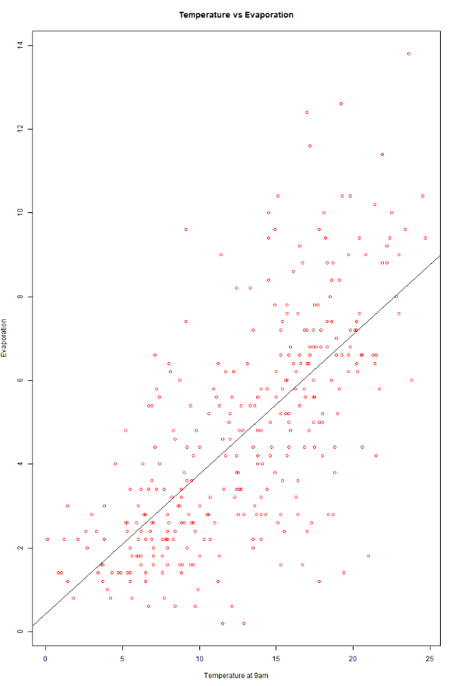
Plots and Observation
Temperature vs Evaporation
Observation: Evaporation increases with Temperature

Slide 17
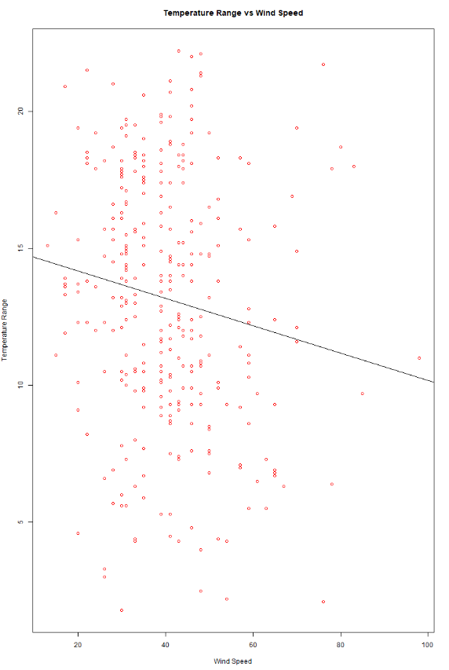
Plots and Observation
Temperature Range vs Wind Speed
Observation: As temperature difference increases wind speed increases

Slide 18
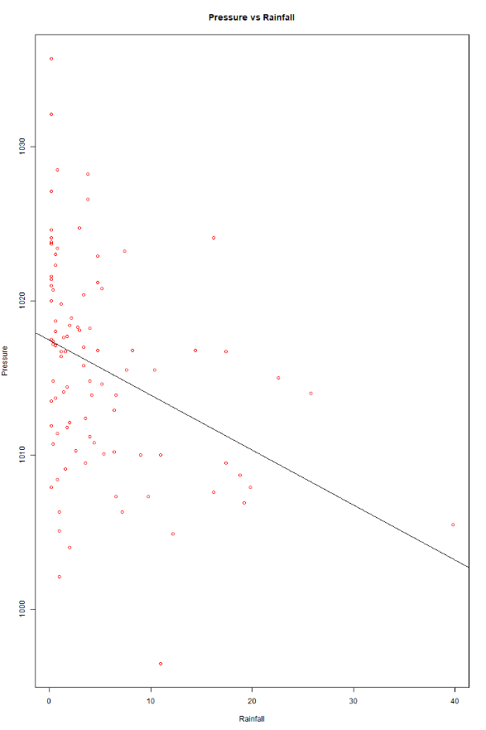
Plots and Observation
Pressure vs Rainfall
Observation: As pressure increases, rainfall decreases

Slide 19
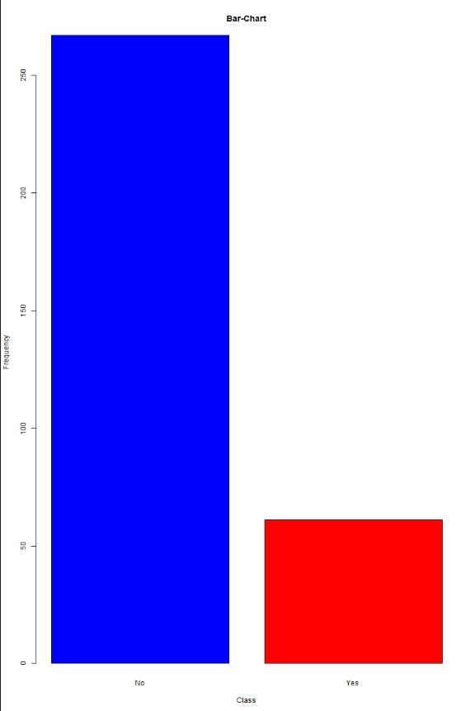
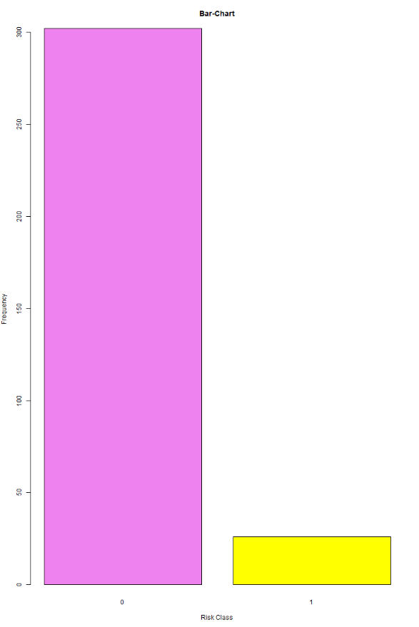
Plots and Observation
Rainfall and frequency
Risk and frequency
Observation: Frequency of rainfall in dataset
Observation: Shows relation between Risk calculated and observed

Slide 20
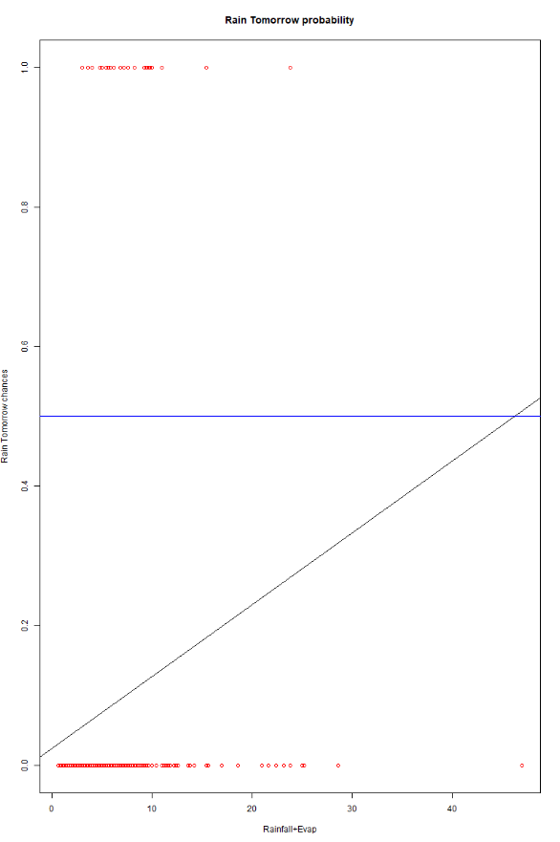
Plots and Observation
Logistic Regression
Observation: Predicts probability of rain from given attributes. Here, we gave Evaporation and Wind speed as attributes

Slide 21
References
https://www.kaggle.com/datasets/mahendran1/weather-data-in-india-from-1901-to-2017
https://cdsp.imdpune.gov.in/
https://datasetsearch.research.google.com/

Slide 22
Thanks

